Slide 1
EMPIRICAL PROPAGATION MODELS

Slide 2
Introduction
Empirical propagation models are measurement-based radio wave propagation models developed from extensive field experiments.
Unlike theoretical models (e.g., Free Space), empirical models incorporate real environmental effects such as buildings, terrain, foliage, and human activity.

Slide 3
The mobile radio channel places fundamental limitations on the performance of a wireless communication system
The wireless transmission path may be
Line of Sight (LOS)
Non line of Sight (NLOS)
Radio channels are random and time varying
Modeling radio channels have been one of the difficult parts of mobile radio design and is done in statistical manner
When electrons move, they create EM waves that can propagate through space.
By using antennas we can transmit and receive these EM wave
Microwave ,Infrared visible light and radio waves can be used.

Slide 4
Properties of Radio Waves
Are easy to generate
Can travel long distances
Can penetrate buildings
May be used for both indoor and outdoor coverage
Are omni-directional-can travel in all directions
Can be narrowly focused at high frequencies(>100MHz) using
parabolic antenna

Slide 5
Outdoor propagation Environment
Based on the coverage area, the Outdoor propagation environment may be divided into three categories
Propagation in Macro cells
Propagation in Micro cells
Propagation in street Micro cells

Slide 6
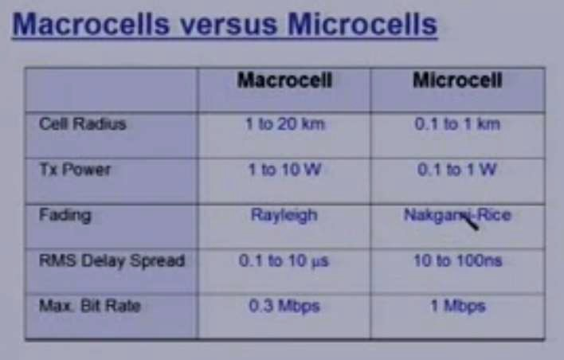
Outdoor propagation Environment

Slide 7
Outdoor propagation Models
Outdoor radio transmission takes place over an irregular terrain.
The terrain profile must be taken into consideration for estimating the path loss
e.g. trees buildings and hills must be taken
into consideration
Some common models used are
Longley Rice Model
Okumura Model
Hatta model

Slide 8
Longley Rice Model
Longley Rice Model is applicable to point to point communication.
It covers 40MHz to 300 GHz
It can be used in wide range of terrain
Path geometry of terrain and the refractivity of troposphere is used for transmission path loss calculations
Geometrical optics is also used along with the two ray model for the calculation of signal strength.
Two modes
Point to point mode prediction
Area mode prediction

Slide 9
Longley Rice Model is normally available as a computer program which takes inputs as
Transmission frequency
Path length
Polarization
Antenna heights
Surface reflectivity
Ground conductivity and dialectic constants
Climate factors
A problem with Longley rice is that It doesn't take into account the buildings and multipath.

Slide 10
Okumura Model
In 1968 Okumura did a lot of measurements and produce a new model.
The new model was used for signal prediction in Urban areas.
Okumura introduced a graphical method to predict the median attenuation relative to free-space for a quasi- smooth terrain
The model consists of a set of curves developed from measurements and is valid for a particular set of system parameters in terms of carrier frequency, antenna height, etc.

Slide 11
First of all the model determined the free space path loss
of link.
After the free-space path loss has been computed, the median attenuation, as given by Okumura’s curves has to be taken to account
The model was designed for use in the frequency range 200 up to 1920 MHz and mostly in an urban propagation environment.
Okumura’s model assumes that the path loss between the TX and RX in the terrestrial propagation environment can be expressed as:

Slide 12
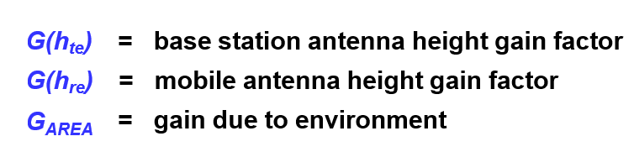
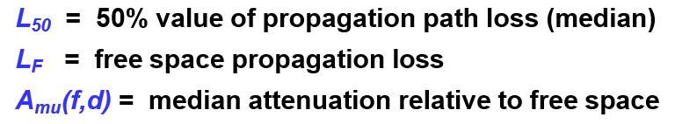
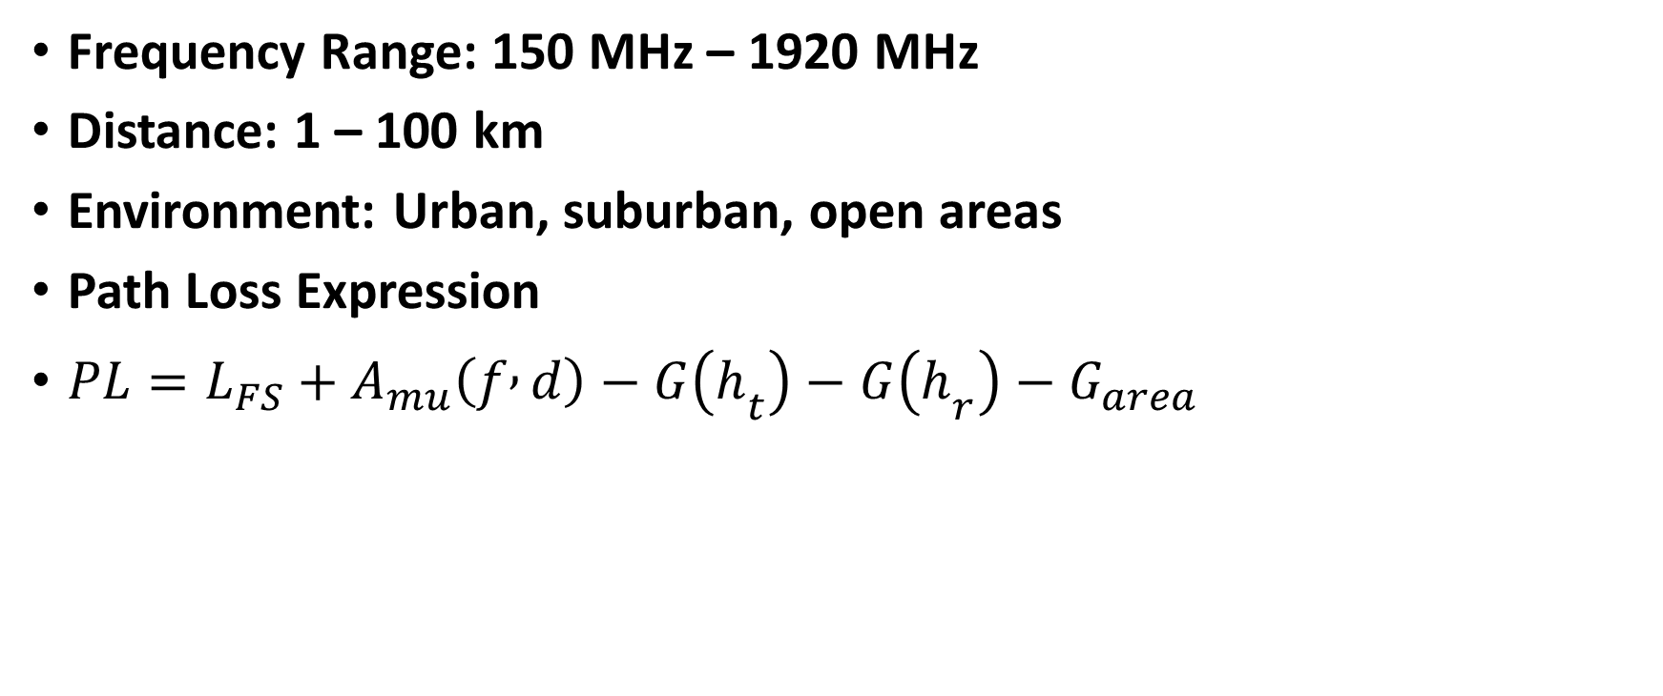
Frequency Range: 150 MHz – 1920 MHz
Distance: 1 – 100 km
Environment: Urban, suburban, open areas
Path Loss Expression
$PL=L_{FS}+A_{mu}\left(f , d\right)−G\left(h_{t}\right)−G\left(h_{r}\right)−G_{area}$

Slide 13
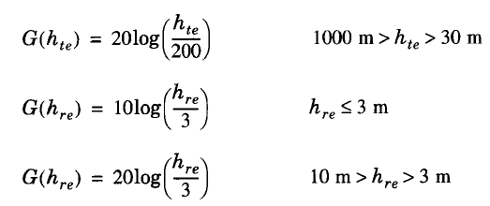
A_{mu}(f,d) & G_{AREA} have been plotted for wide range of frequencies
Antenna gain varies at rate of 20dB or 10dB per decade
Model corrected for
Δh = terrain undulation height, isolated ridge height average terrain slope and mixed land/sea parameter

Slide 14
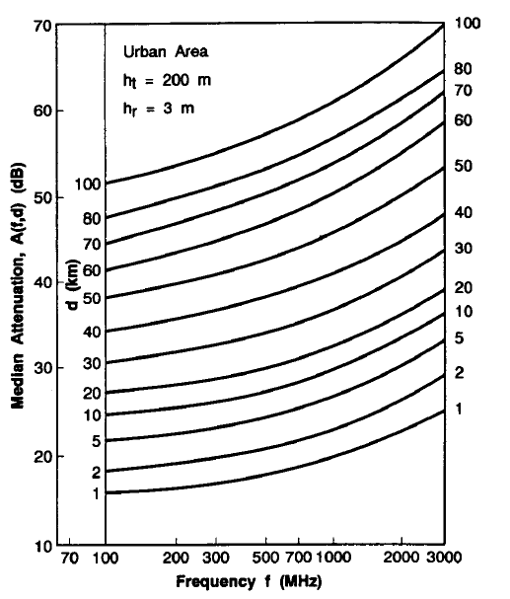
Median Attenuation Relative to Free Space = A_{mu}(f,d) (dB)

Slide 15
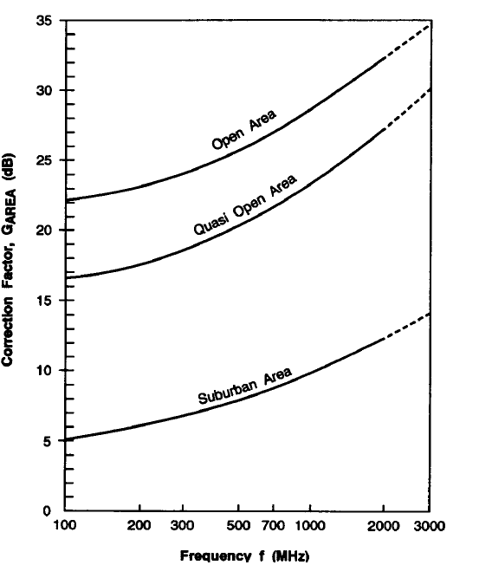
Correction Factor G_{AREA}

Slide 16
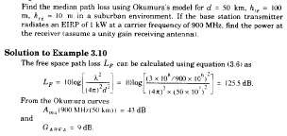
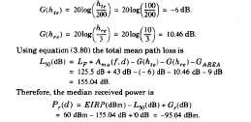
Example

Slide 17
Hata Model
Most widely used model in Radio frequency.
Predicting the behavior of cellular communication in builtup areas.
Applicable to the transmission inside cities.
Suited for point to point and broadcast transmission.
150 MHz to 1.5 GHz, Transmission height up to 200m and link distance less than 20 Km.

Slide 18
Hata transformed Okumura’s graphical model into an analytical framework.
The Hata model for urban areas is given by the empirical formula:
L50, _{urban} = 69.55 dB +26.16 log(f_{c})- 3.82 log(h_{t}) -a(h_{r}) + (44.9 − 6.55 log(h_{t})) log(d)
Where L50, _{urban} is the median path loss in dB.
The formula is valid for
150 MHz<=f_{c}<=1.5GHz,
1 m<=h_{r}<=10m, 30m<=h_{t}<=200m,
1km<d<20km

Slide 19
The correction factor a(h_{r}) for mobile antenna height hr for a small or medium-sized city is given by:
a(h_{r}) = (1.1 logf_{c} − 0.7)h_{r} − (1.56 log(f_{c}) − 0.8) dB
For a large city it is given by
a(h_{r}) = 8.29[log(1.54h_{r})]² − 1.10 dB for f_{c} <=300 MHz
3.20[log (11.75h_{r})]² − 4.97 dB for f_{c} >= 300 MHz
To obtain path loss for suburban area the standard Hata model is
modified as
L₅₀ =L₅₀(urban)-2[log(f_{c}/28)]²-5.4
For rural areas
L₅₀ =L₅₀(urban)-4.78log(f_{c})²-18.33logf_{c} -40.98

Slide 20
Indoor Models
Indoor Channels are different from traditional channels in two ways
The distances covered are much smaller
The variability of environment is much greater for a much small range of Tx and Rx separation.
Propagation inside a building is influenced by:
Layout of the building
Construction materials
Building Type: office , Home or factory

Slide 21
Indoor Models
Indoor models are dominated by the same mechanism as out door models:
Reflection, Diffraction and scattering
Conditions are much more variable
Doors/Windows open or not
Antenna mounting : desk ceiling etc
The levels of floor
Indoor models are classifies as
Line of sight (LOS)
Obstructed (OBS) with varying degree of clutter

Slide 22
Indoor Models
Portable receiver usually experience
Rayleigh fading for OBS propagation paths
Ricean fading for LOS propagation path
Indoors models are effected by type of building e.g. Residential buildings, offices, stores and sports area etc.
Multipath delay spread
Building with small amount of metal and hard partition
have small delay spread 30 to 60ns
Building with large amount of metal and open isles
have delay spread up to 300ns

Slide 23
Partition losses (same floor)
Two types of partitions
hard partitions: Walls of room
Soft partitions : Moveable partitions that donot span to ceiling
Partitions vary widely in their Physical and electrical properties.
Path loss depend upon the types of partitions

Slide 24
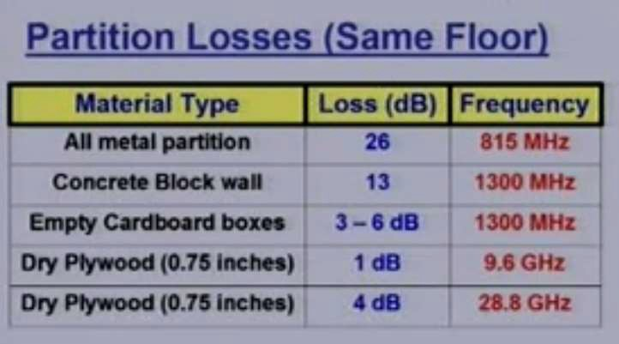
Partition losses (same floor)

Slide 25
Partitions losses (between floors)
Partition losses between the two floors depend on
External dimension and material used for buildings
Types of construction used to create floors
External surroundings
No of windows used
Tinting on the windows
Floor Attenuation Factor (FAF) increases as we increase the no of floors

Slide 26
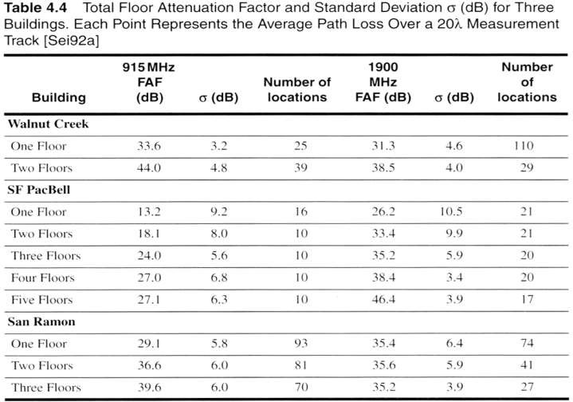
Partitions losses (between floors)

Slide 27
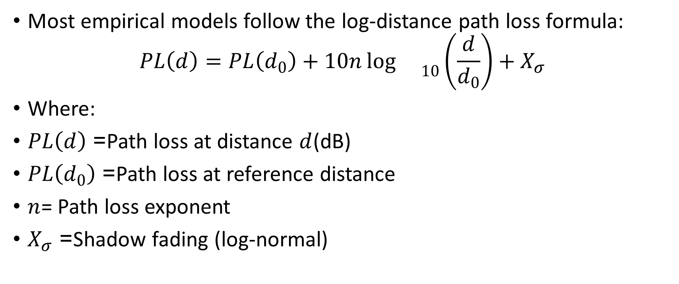
Log distance path loss model
Most empirical models follow the log-distance path loss formula:
$$PL\left(d\right)=PL\left(d_{0}\right)+10n{\log{}}_{10}\left(\frac{d}{d_{0}}\right)+X_{σ}$$
Where:
$PL\left(d\right)$= Path loss at distance $d$(dB)
$PL\left(d_{0}\right)$= Path loss at reference distance
$n$= Path loss exponent
$X_{σ}$= Shadow fading (log-normal)

Slide 28
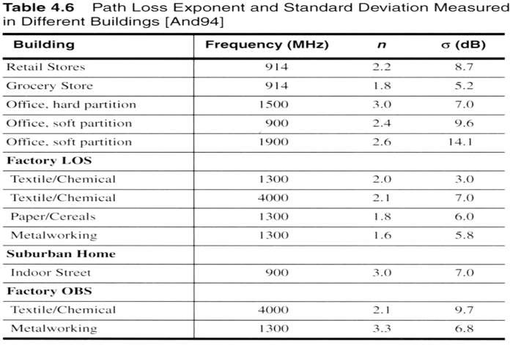
Log distance path loss model

Slide 29
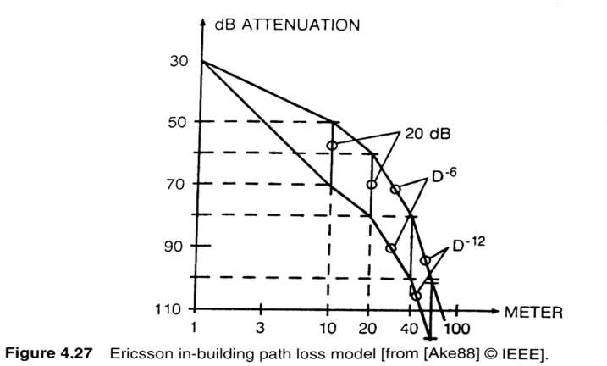
Ericsson Multiple Break Point Model

Slide 30
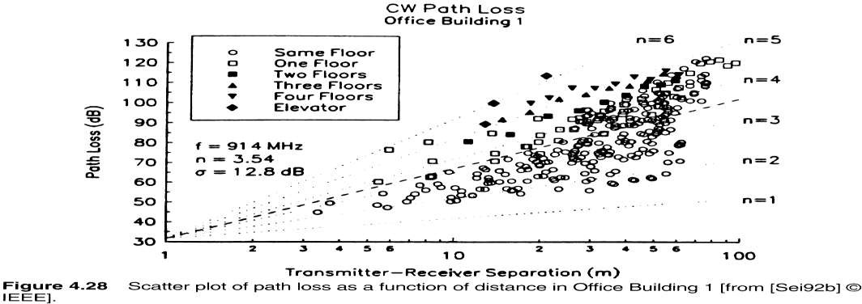
Attenuation factor model
Obtained by measurement in multiple floors building

Slide 31
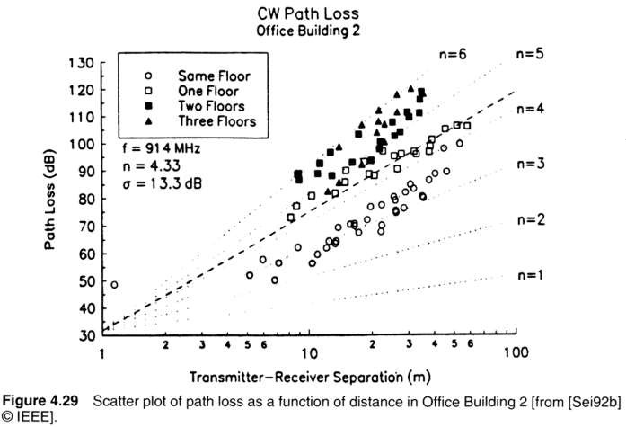
Attenuation factor model

Slide 32
Signal penetration into building
Effect of frequency
- Penetration loss decreases with increasing frequency
Effect of Height
Penetration loss decreases with the height of building up to some certain height.
- At lower heights the Urban clutter induces greater attenuation
Up to some height attenuation decreases but then again
increase after a few floors
Increase in attenuation at higher floors is due to the
Shadowing effects of adjacent buildings

Slide 33
Large, medium and small scale fading
Large Scale Fading: Average signal power attenuation/path loss due to motion over large areas.
Medium scale fading: Local variation in the average signal power around mean average power due to shadowing by local obstructions
Small scale fading: large variation in the signal power due to small changes in the distance between transmitter and receiver (Also called Rayleigh fading when no LOS available). It is called Rayleigh fading due to the fact that various multipaths at the receiver with random amplitude & delay add up together to render rayleigh PDF for total signal.

Slide 34
Cause of Multipath Fading
Fading : Fluctuation in the received signal power due to
Variations in the received singal amplitude (Different objects present on radio signal path produce attenuation of it’s power as they can scatter or absorb part of the signal power, thus producing a variation of the amplitude
Variations in the signal phase
Variations in the received signal angle of arrival (different paths travelling different distances may have different phases & angle of arrival)

Slide 35
Causes of Multipath fading Cont..
Reflections and diffraction from object create many different EM waves which are received in mobile antenna. These waves usually come from many different directions and delay varies.
In the receiver, the waves are added either constructively or destructively and create a Rx signal which may very rapidly in phase and amplitude depending on the local objects and how mobile moves

Slide 36
Practical examples of small scale multipath fading
Common examples of multipath fading are
temporary failure of communication due to a severe drop in the channel signal to noise ratio (You may have also experienced this. And you moved a steps away & noted that reception is better. It is due to small scale fading effects. ☺)
FM radio transmission experiencing intermittent loss of broadcast when away from station.

Slide 37
Multipath Fading- Most difficult
Fades of 40 dB or more below local average level are frequent, with successive nulls occurring every half wavelength or so
Referred to as Rayleigh Fading

Slide 38
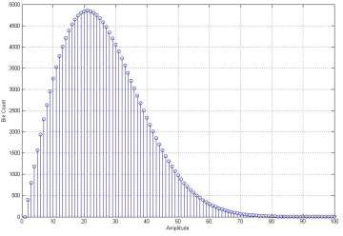
Rayleigh Fading Mechanism
Rayleigh fading manifests in two mechanism
Time spreading due to multipath (time dispersion)
Time variant behaviour of the channel due to the motion and subsequent changes in propagation paths
Rayleigh PDF:

Slide 39
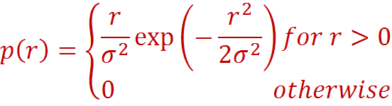
Rayleigh Fading
The Rayleigh pdf is

Slide 40
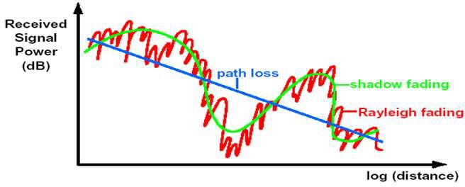
With Rayleigh Fading

Slide 41
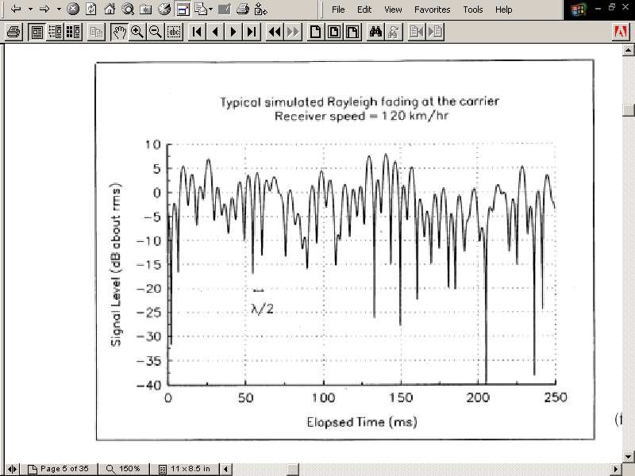
Rayleigh Fading waveform envelope

Slide 42
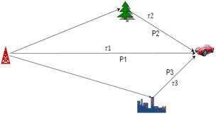
Time Dispersion phenomenon
h(t)
time
Freq transform
Freq
Different frequencies suffer different attenuation

Slide 43
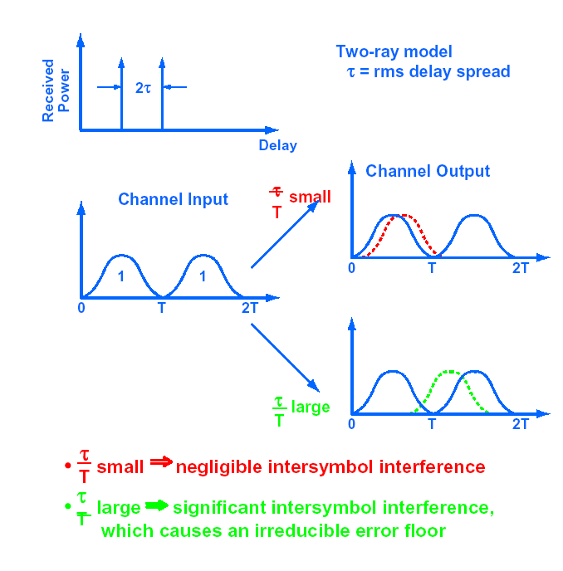
Delay Spread –Time Domain
interpretation
Delay spread is a key parameter that describes time dispersion of a wireless channel due to multipath propagation. It measures how much a transmitted signal is spread in time when it arrives at the receiver.

Slide 44
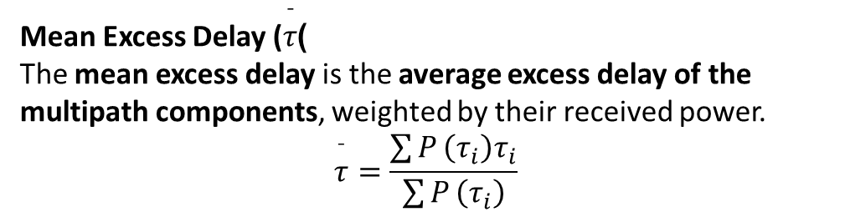

Multiple impulses of varying power correspond to various multipaths.
This time dispersion is also referred to as multipath delay spread.
Delay between first significant path & last significant paths
is loosely termed as channel excess delay spread.
Two totally different channels can have same excess
delay spread.
A better measure of delay spread is rms delay spread
RMS Delay Spread (Most Important)
Statistical measure of time dispersion around the mean delay.
$$σ_{τ}=\sqrt{\frac{\sum{P}\left(τ_{i}\right)\left(τ_{i}−\overset{ˉ}{τ}{\left.)\right.}^{2}\right.}{\sum{P}\left(τ_{i}\right)}}$$
​
This is the most widely used form of delay spread in system design.
Mean Excess Delay ($\overset{ˉ}{τ}$)
The mean excess delay is the average excess delay of the multipath components, weighted by their received power.
$$\overset{ˉ}{τ}=\frac{\sum{P}\left(τ_{i}\right)τ_{i}}{\sum{P}\left(τ_{i}\right)}$$

Slide 45
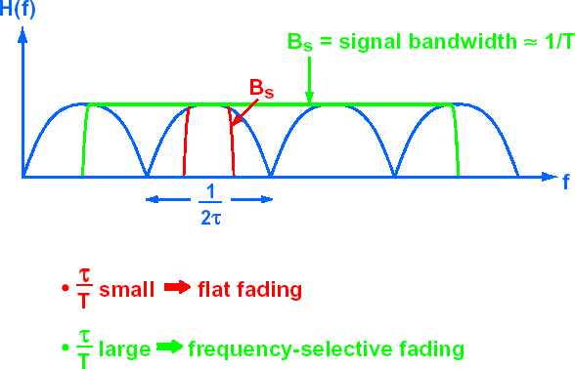
Delay Spread- Freq. Domain Interpretation

Slide 46
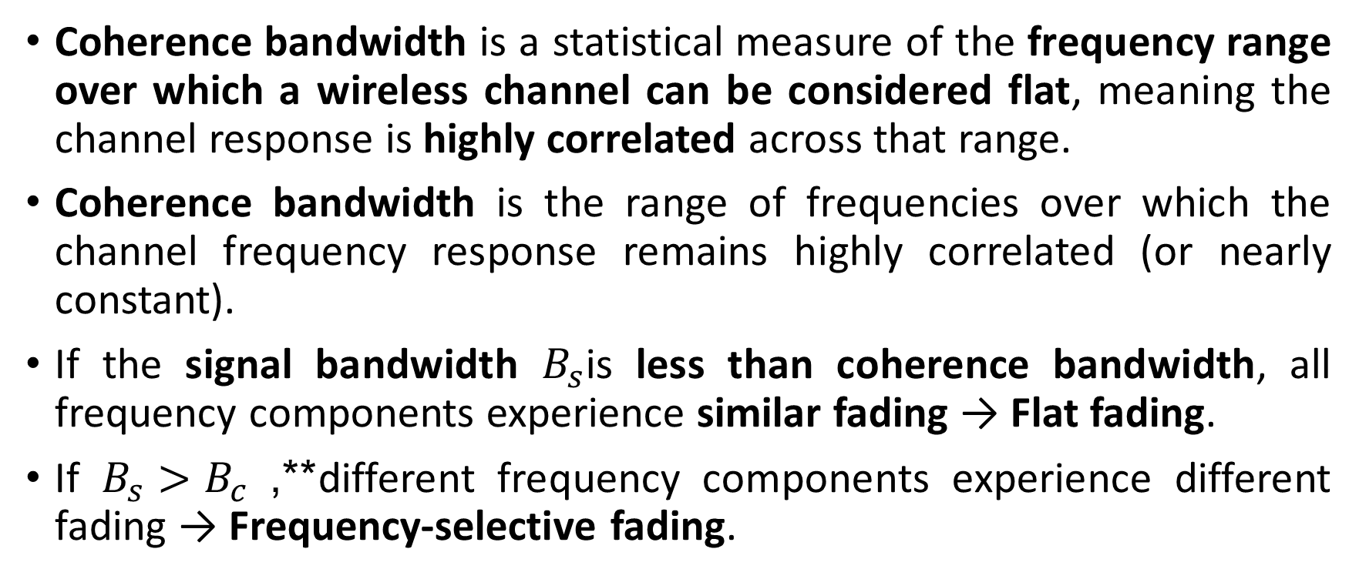
Coherence Bandwidth
Coherence bandwidth is a statistical measure of the frequency range over which a wireless channel can be considered flat, meaning the channel response is highly correlated across that range.
Coherence bandwidth is the range of frequencies over which the channel frequency response remains highly correlated (or nearly constant).
If the signal bandwidth $B_{s}$is less than coherence bandwidth, all frequency components experience similar fading → Flat fading.
If $B_{s}>B_{c}$**, different frequency components experience different fading → Frequency-selective fading.

Slide 47
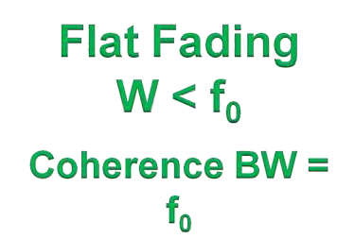
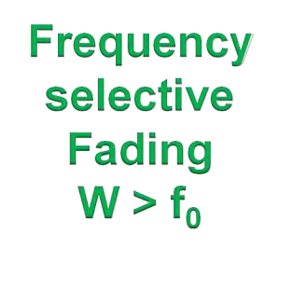
Time spreading : Coherence Bandwidth
Channel frequency response
W
f₀
Freq
Channel frequency response
W
Freq

Slide 48
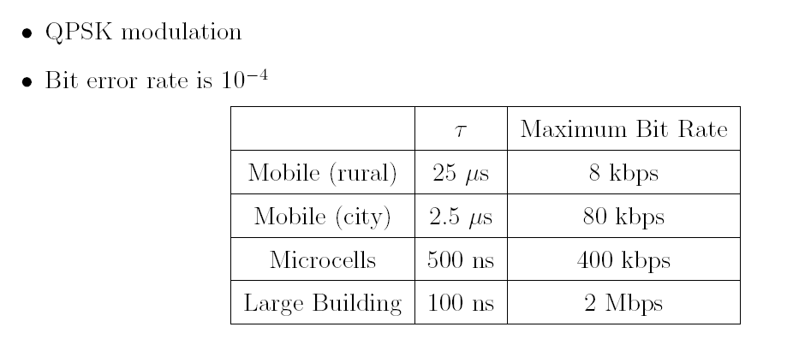
Bit Rate Limitations by Delay Spread

Slide 49
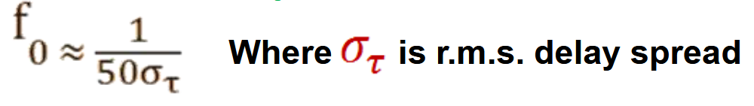

Coherence Bandwidth and delay spread
There is no exact relationship between Coherence bandwidth and delay spread. For at least 0.9 correlation for channel’s complex frequency transfer function, Coherence bandwidth f0 is approximated by following relation:
Another popular approximation assuming at least 0.5 correlation:
$$B_{c}≈\frac{1}{5σ_{τ}}$$

Slide 50
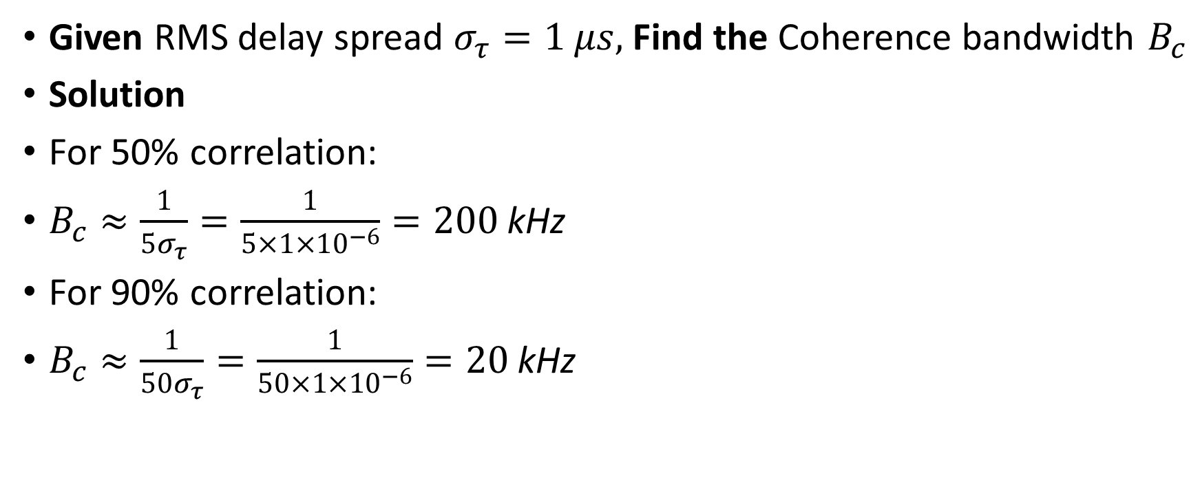
Example
Given RMS delay spread $σ_{τ}=1 μs,$Find the Coherence bandwidth $B_{c}$
Solution
For 50% correlation:
$B_{c}≈\frac{1}{5σ_{τ}}=\frac{1}{5×1×{10}^{−6}}=200 \text{kHz}$
For 90% correlation:
$B_{c}≈\frac{1}{50σ_{τ}}=\frac{1}{50×1×{10}^{−6}}=20 \text{kHz}$

Slide 51

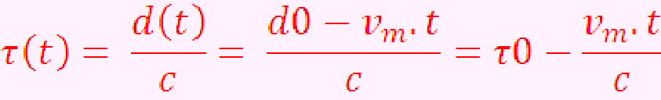
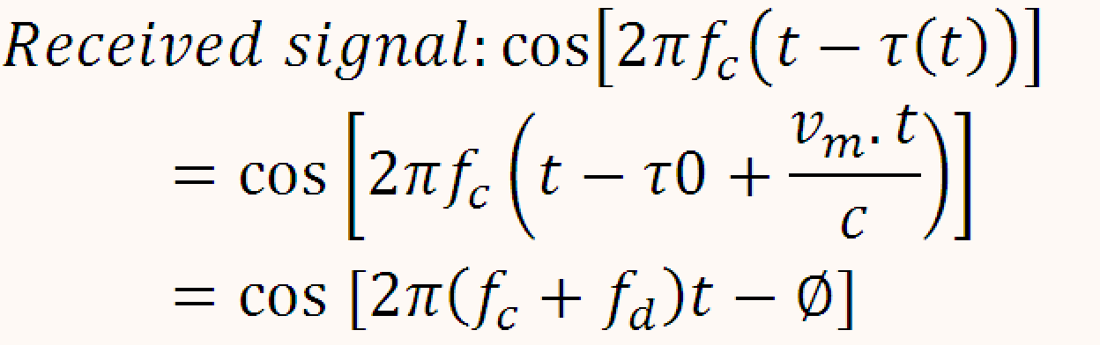
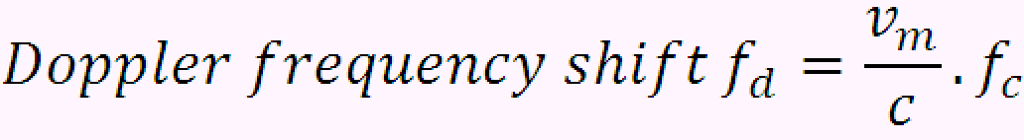
Basic Doppler effect
t)
c is the light velocity and vm is the car speed
Propagation time is a function of time due to
mobile car.

Slide 52
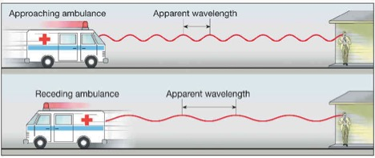
Doppler shift
Change in frequency when transmitter and receiver are mobile in nature.
Higher frequency – when both move towards
Lower frequency – when both move away

Slide 53
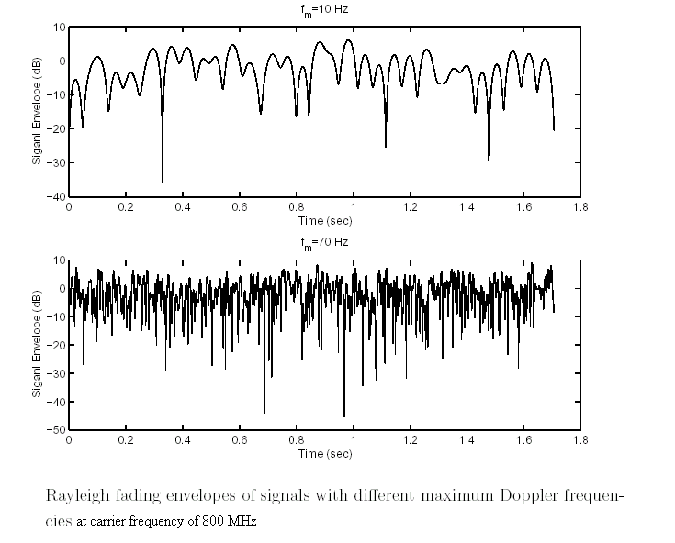
Waveform of Rayleigh Fading Signal

Slide 54


Time Variance : Fast Fading
Fast Fading :
Where T_{s} : Transmitted Symbol time
Or
Where W: Transmitted bandwidth
Above relationship means that channel changes drastically many times while a symbol is propagating;
Only highly mobile systems (~500 Km/Hr) will have fd ~1 kHz so systems having signalling rate of that order will be fast fading.
Impact of fast fading:
Severe distortion of baseband pulse leading to detection
problems
Loss in SNR
Synchronization problems (e.g. Failure of PLL)

Slide 55


Time variance: Slow Fading
Slow Fading :
where T_{s} : Transmitted Symbol time
Or
where W: Transmitted bandwidth
Above relationship means that channel does not change drastically during symbol duration
Most of the modern communication systems are slow fading channels
Impact of fast fading:
Loss in SNR

Slide 56
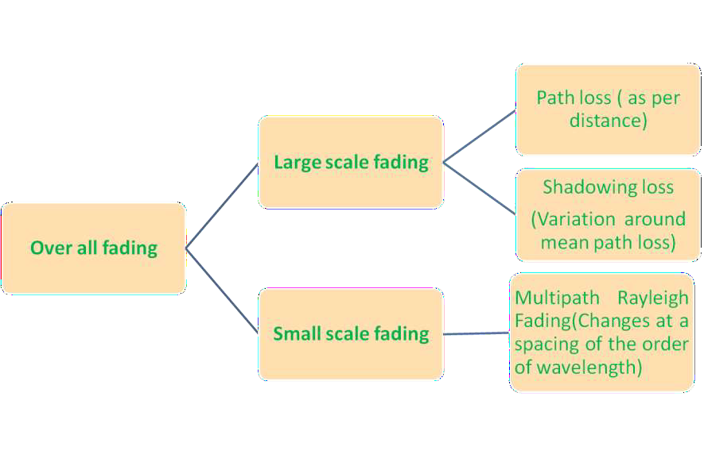
Summary of Overall Fading

Slide 57
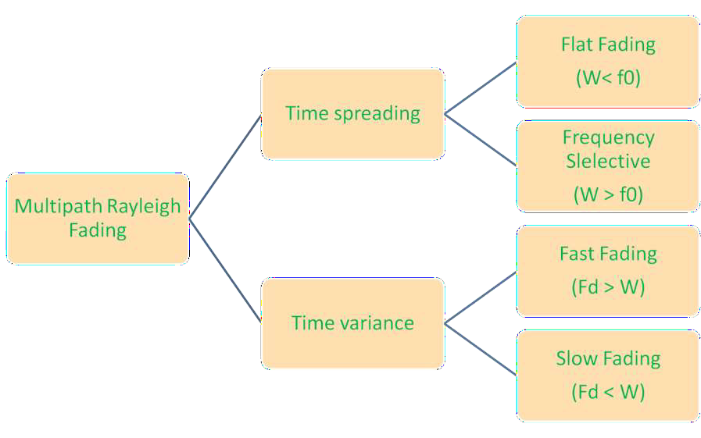
Summary of Multipath Fading characterization

Slide 58
Assignment (10Marks)
You are required to conduct a field-based measurement study to evaluate the performance of empirical radio propagation models in a real outdoor environment.
Using an existing cellular base station (GSM/LTE/5G) within your study area:
Collect received signal strength measurements (RSSI/RSRP) at not less than ten (10) different locations using a smartphone-based measurement application.
Determine the separation distance between the base station and each measurement point using GPS coordinates.
Compute the measured path loss at each location from the collected data.
Estimate the path loss using:
the Hata model, and
the COST-231 Hata model, for the same distances and operating frequency.
Plot and compare the measured path loss with the predicted path loss obtained from the two empirical models.
Evaluate the accuracy of each model by calculating the Root Mean Square Error (RMSE).
Discuss the suitability of the empirical models for the selected environment (urban, suburban, or rural) and propose possible model tuning to improve prediction accuracy.
Softwares to be used are Cellmapper/G-Net Track/Google map/Matlab etc.

